Slide 1
Dynamic programming algorithms for the mosaic longest common subsequence problem
Kuo-Si Huang, Chang-Biau Yang ∗, Kuo-Tsung Tseng,Yung-Hsing Peng, Hsing-Yen Ann
Information Processing Letters, Vol. 102, pp. 99-103, 2007
Date: Mar. 21, 2007
Introducer: Chung-Han Chiang

Slide 2
Abstract
The longest common subsequence (LCS) problem can be used to measure the relationship between sequences. In general, the inputs of the LCS problem are two sequences.
For finding the relationship between one sequence and a set of sequences, we cannot apply the traditional LCS algorithms immediately. In this paper, we define the mosaic LCS (MLCS) problem of finding a mosaic sequence C, composed of repeatable k sequences in source sequence set S, such that the LCS of C and the target sequence T is maximal.
Based on the concept of break points in sequence T , we first propose a divide-and-conquer algorithm with O(n²m|S| + n³ log k) time for solving this problem, where n and m are the length of T and the maximal length of sequences in S, respectively. Furthermore, an improved algorithm with O(n(m+k)|S|) time is proposed by applying an efficient preprocessing for the MLCS problem.

Slide 3
Introduction
The LCS is used to find the relationship of two sequences. If we desire to know the relationship between one sequence and a set of sequences, the original LCS algorithms cannot return the relationship directly and hence a new algorithm should be designed.

Slide 4
Mosaic LCS (MLCS)
The mosaic longest common subsequence (MLCS) problem is defined as follows. Given a target (query) sequence T , a mosaic number k, k≧1, and a set of source sequences S, find a k-mosaic (k-concatenate) sequence C = C₁C₂ . . . C_{k} , C_{i} ∈ S and 1≦i≦k, such that LCS(T ,C) is maximal.

Slide 5
Example
For example, suppose T = agactagtc, k = 3, and S = {S₁ = agc, S₂ = act, S₃ = aatg, S₄ = ttcg}.
We can find C = agc act agc such that LCS(T ,C) = agactagc with length 8.
If k = 4, we can construct another C = agc act agc ttcg such that LCS(T ,C) = agactagtc with length 9.

Slide 6

Algorithms
r
T
C
C₁
C₂

Slide 7


r
T
C
C₁
C₂
…
C_{k}

Slide 8
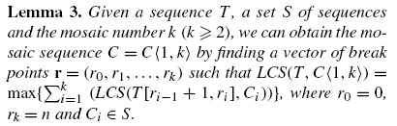
r₁
r₂
…
r_{k}
T
C
…
C₁
C₂
C_{k}

Slide 9
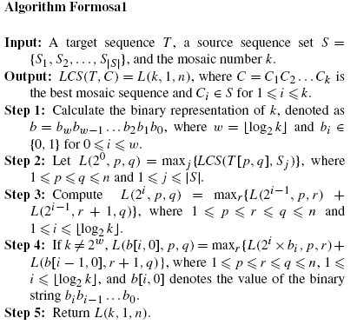
Algorithm Formosa1 solves the MLCS problem in O(n²m|S| + n³ log k) time.
O( log₂k )
O( n²m|S| )
O( n³logk )
O( n³logk )
Maximal LCS length

Slide 10
L (l,p,q) denotes the best LCS length of all possible l-mosaic sequences and T [p,q]
L (2⁰,p,q) = L (1,p,q) = max_{j} {LCS (T[p,q],s_{j}) }
While fixing S_{j} and the p of T[p,q] , we can compute the LCS(T[p,q],S_{j}) in O(mn) time.
EX: T = agactagtc S = {S1 = agc ,S2 = act ,S3 = aatg ,S4 = ttcg} , j = 1, p = 1,
 | a | g | a | c | t | a | g | t | c
a | 1 | 1 | 1 | 1 | 1 | 1 | 1 | 1 | 1
g | 1 | 2 | 2 | 2 | 2 | 2 | 2 | 2 | 2
c | 1 | 2 | 2 | 3 | 3 | 3 | 3 | 3 | 3
L(1,1,1) = 1
L(1,1,2) = 2
L(1,1,3) = 2
︰
L(1,1,9) = 3
→O(n²m|S|)

Slide 11
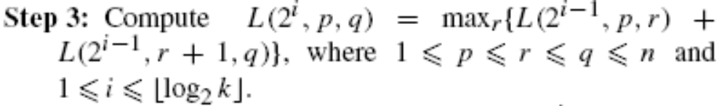
L(2^{i},p,q) = max_{r}{L(2^{i-1},p,r)+L(2^{i-1},r+1,q)}
Suppose k = 2, i = log₂k = 1,
L(2^{i},p,q) = L(2,p,q) = max_{r}{L(1,p,r)+L(1,r+1,q)}
Suppose k = 4, i = log₂k = 2,
L(2^{i},p,q) = L(4,p,q) = max_{r}{L(2,p,r)+L(2,r+1,q)}
→O(n³logk)

Slide 12

L(b[i,0], p,q) = max_{r}{L(2^{i}Xb_{i},p,r) + L(b[i-1,0],r+1,q) }
b[i,0] denotes the value of the binary string b_{i}b_{i-1}…b₀
Suppose k = 3, log₂k ≧1.5, 3 = 11₍₂₎, b₀ = 1,b₁ =1.
L(b[i,0], p,q) = L(b[1,0], p,q) = max_{r} { L(2¹X1,p,r) + L(b{0,0],r+1,q) }
= max_{r} { L(2,p,r) + L(1,r+1,q) }
→O(n³logk)

Slide 13
S-table
The S-table of two sequences T and X, denoted as S^{t} (T ,X), stores the LCS length of X and each suffix string T [i, n] of T , 1≦i≦n.

Slide 14
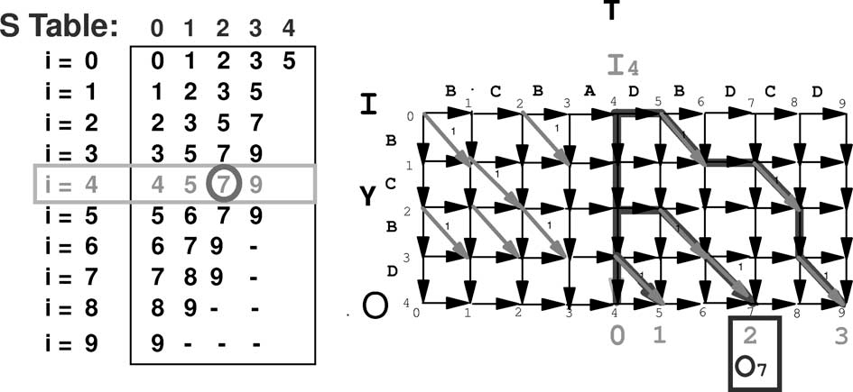
Example
T = BCBADBDCD , X = BCBD

Slide 15
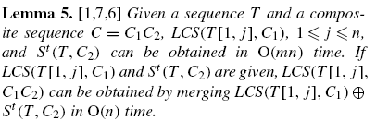
 | 0 | 1 | 2 | 3
0 | 0 | 1 | 2 | 3
1 | 1 | 2 | 3
2 | 2 | 3 | 6
3 | 3 | 5 | 6
4 | 4 | 5 | 7
5 | 5 | 6 | -
6 | 6 | 7 | -
7 | 7 | - | -
T = agctacc , C = C₁C₂ C₁ =aatc , C₂ = agc .
 | a | g | c | t | a | c | c
a | 1 | 1 | 1 | 1 | 1 | 1 | 1
a | 1 | 1 | 1 | 1 | 2 | 2 | 2
t | 1 | 1 | 1 | 2 | 2 | 2 | 2
c | 1 | 1 | 2 | 2 | 2 | 3 | 3
LCS(T[1,j] , C₁) →O(mn)
S^{t}( T , C₂) →O(mn)

Slide 16
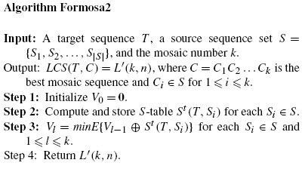
Algorithm Formosa2 solves the MLCS problem in O(n(m +k)|S|) time.
O( nm|S| )
O( nk|S| )

Slide 17
Based on Lemma 5, we can obtain S^{t} (T , S_{i} ) while computing LCS(T , S_{i} ).
< Need O(mn)>
And there are |S| source sequences, so we need O(mn)X|S| = O(nm|S|) time.

Slide 18
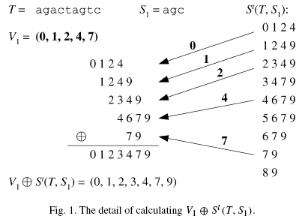
T = agactagtc , S = {S₁ = agc,S₂ = act,S₃ = aatg,S₄ = ttcg}.
 | 0 | 1 | 2 | 3
1 | 0 | 1 | 2 | 4
2 | 1 | 2 | 4 | 9
3 | 2 | 3 | 4 | 9
4 | 3 | 4 | 7 | 9
5 | 4 | 6 | 7 | 9
6 | 5 | 6 | 7 | 9
7 | 6 | 7 | 9 | -
8 | 7 | 9 | - | -
9 | 8 | 9 | - | -
S^{t}(T, S₁)
V₀ ⊕S^{t} (T , S₁ ) are (0, 1, 2, 4), V₀ ⊕S^{t} (T , S₂ ) are (0, 1, 4, 5)
V₀ ⊕S^{t} (T , S₃ ) are (0, 1, 2, 5, 7), V₀ ⊕S^{t} (T , S₄ ) are (0, 2, 7, 9)
V₁ = minE{(0, 1, 2, 4), (0, 1, 4, 5), (0, 1, 2, 5, 7), (0, 2, 7, 9)} = (0, 1, 2, 4, 7).
V₁ ⊕ S^{t} (T , S₁), which is (0, 1, 2, 3, 4, 7, 9)

Slide 19
Based on Lemma 5, step3 merges the vector V_{l} and the S-table of S_{i} , which each merge can be done in O(n) time.
And 1≦l≦k , |S| source sequence, so we need O(nk|S|) time.
In summary, the time complexity of Algorithm Formosa2 is O(n(m + k)|S|).

Slide 20

Proof. Based on the break point vector r, we can separate T into k segments, i.e., T = T₁T₂ . . . T_{k} . Each segment T_{i} has to consider only its corresponding C_{i} . We can use simple dynamic programming formula to
find out the sequence of LCS(T_{i},C_{i} ) in O(|T_{i} ||C_{i} |) time. Thus, the time required for all k segment pairs of (T_{i},C_{i} ) is O(|T|m) = O(mn).
T₁ T₂ T₃
C₁
ΣT_{i} = T
ΣC_{i} = C
∴the time required O(|T|m) = O(mn)
C₂
C₃

Slide 21
Conclusion
We define the MLCS problem for finding LCS(T ,C) of a mosaic sequence C, composed of repeatable k sequences in set S of source sequences. By applying the S-table, we propose an improved algorithm with O(n(m +k)|S|) time for solving the problem.

